Slide 1
Linear System of Equations - Conditioning

Slide 3
Numerical experiments
Input has uncertainties:
Errors due to representation with finite precision
Error in the sampling
Once you select your numerical method , how much error should you expect to see in your output?
Is your method sensitive to errors (perturbation) in the input?
Demo “HilbertMatrix-ConditionNumber”

Slide 4
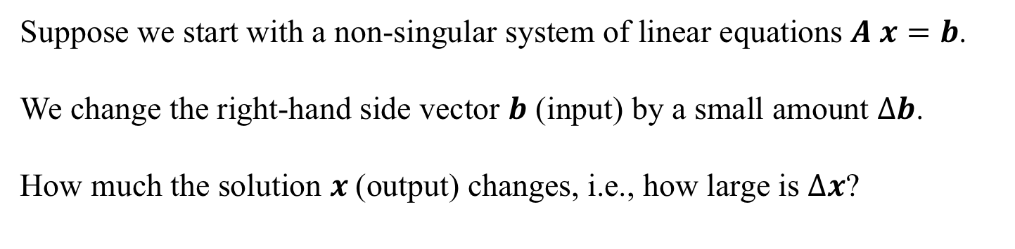
Sensitivity of Solutions of Linear Systems
Suppose we start with a non-singular system of linear equations $A x=b$.
We change the right-hand side vector $b$ (input) by a small amount $Δb$.
How much the solution $x$(output) changes, i.e., how large is $Δx$?
$$\frac{Output Relative error }{Input Relative error}=\frac{\left\|Δx \right\|/\left\|x\right\|}{\left\|Δb \right\|/\left\|b\right\|}=\frac{\left\|Δx \right\| \left\|b\right\|}{\left\|Δb \right\| \left\|x\right\|}$$

Slide 5
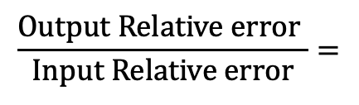
Sensitivity of Solutions of Linear Systems
$$\frac{Output Relative error }{Input Relative error}=\frac{\left\|Δx \right\|/\left\|x\right\|}{\left\|Δb \right\|/\left\|b\right\|}=\frac{\left\|Δx \right\| \left\|b\right\|}{\left\|Δb \right\| \left\|x\right\|}$$
$$\frac{Output Relative error }{Input Relative error}=$$

Slide 6
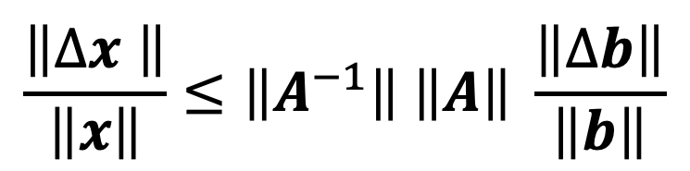
Sensitivity of Solutions of Linear Systems
$$\frac{\left\|Δx \right\|}{\left\|x\right\|}≤\left\|A^{−1}\right\| \left\|A\right\| \frac{\left\|Δb\right\|}{\left\|b\right\|}$$

Slide 7
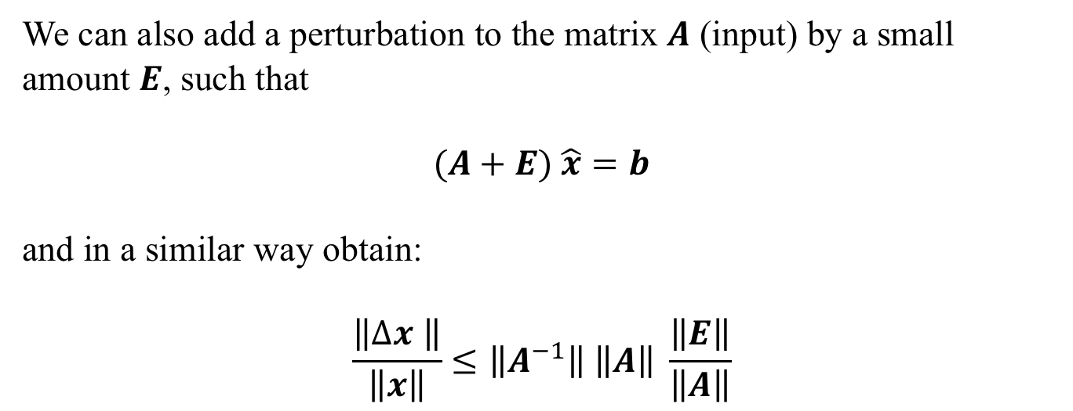
Sensitivity of Solutions of Linear Systems
We can also add a perturbation to the matrix $A$ (input) by a small amount $E$, such that
$$(A+E) \hat{x}=b$$
and in a similar way obtain:
$$\frac{\left\|Δx \right\|}{\left\|x\right\|}≤\left\|A^{−1}\right\| \left\|A\right\| \frac{\left\|E\right\|}{\left\|A\right\|}$$

Slide 8
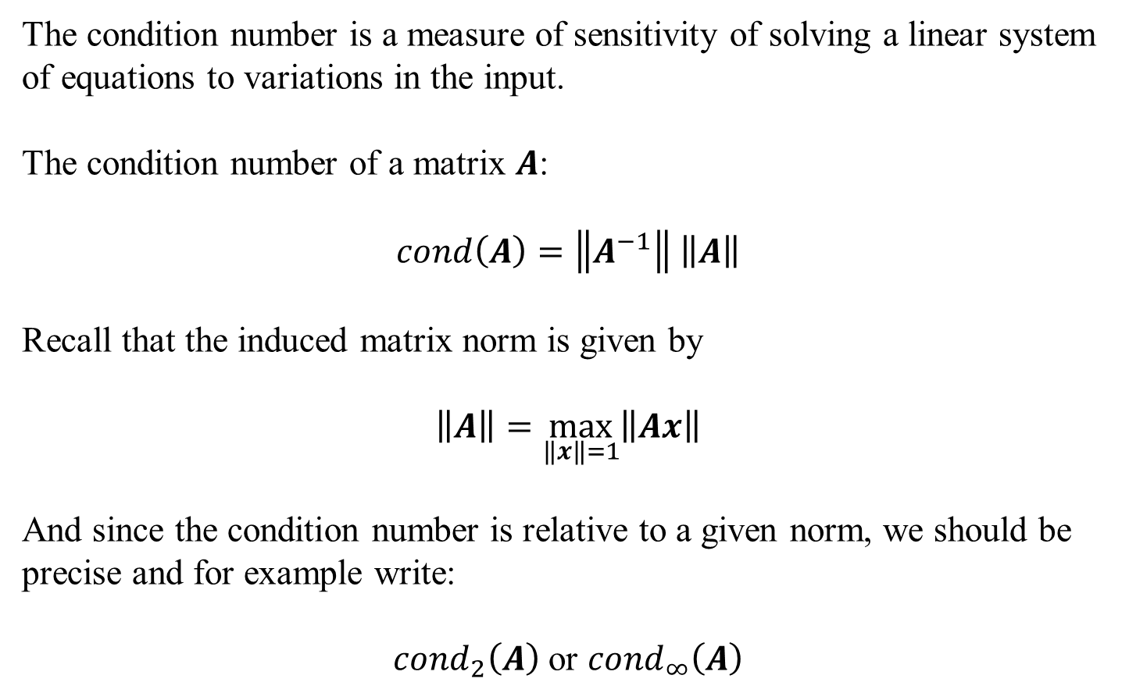
Condition number
The condition number is a measure of sensitivity of solving a linear system of equations to variations in the input.
The condition number of a matrix $A$:
$$cond\left(A\right)=\left\|A^{−1}\right\| \left\|A\right\|$$
Recall that the induced matrix norm is given by
$$\left\|A\right\|=\max_{\left\|x\right\|=1}\left\|Ax\right\|$$
And since the condition number is relative to a given norm, we should be precise and for example write:
${cond}_{2}\left(A\right)$ or ${cond}_{∞}\left(A\right)$
Demo “HilbertMatrix-ConditionNumber”

Slide 9
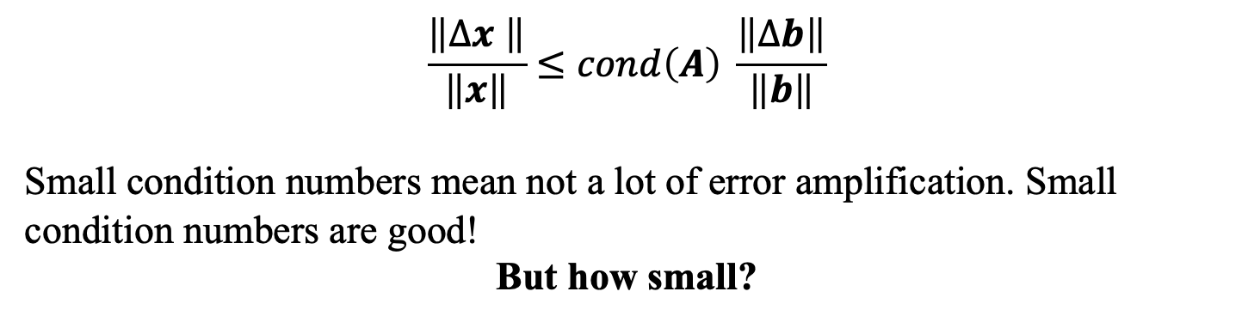
Condition number
$$\frac{\left\|Δx \right\|}{\left\|x\right\|}≤cond\left(A\right) \frac{\left\|Δb\right\|}{\left\|b\right\|}$$
Small condition numbers mean not a lot of error amplification. Small condition numbers are good!
But how small?

Slide 10
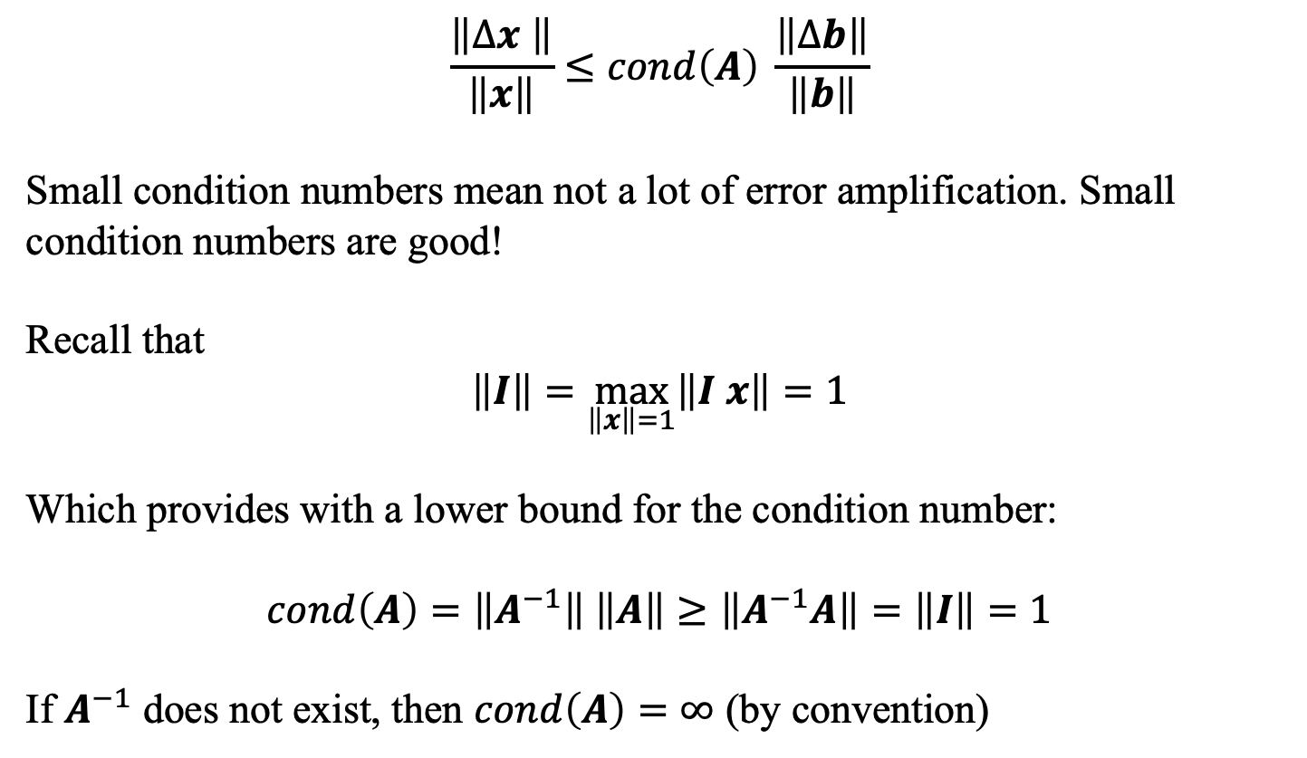
Condition number
$$\frac{\left\|Δx \right\|}{\left\|x\right\|}≤cond\left(A\right) \frac{\left\|Δb\right\|}{\left\|b\right\|}$$
Small condition numbers mean not a lot of error amplification. Small condition numbers are good!
Recall that
$$\left\|I\right\|=\max_{\left\|x\right\|=1}\left\|I x\right\|=1$$
Which provides with a lower bound for the condition number:
$$cond\left(A\right)=\left\|A^{−1}\right\| \left\|A\right\|≥\left\|A^{−1}A\right\|=\left\|I\right\|=1$$
If $A^{−1}$ does not exist, then $cond\left(A\right)=∞$ (by convention)

Slide 11
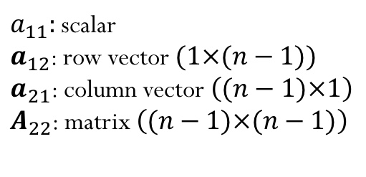
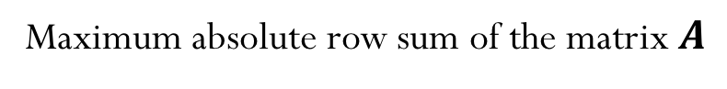
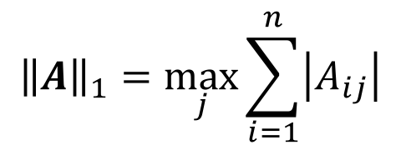
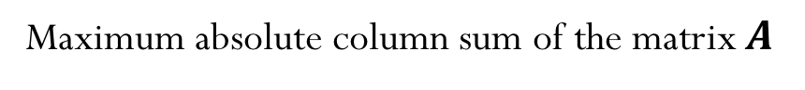
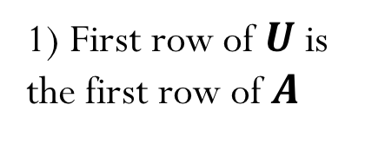
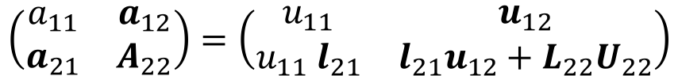
Recall Induced Matrix Norms
$${\left\|A\right\|}_{1}=\max_{j}{\sum_{i=1}^{n}{\left|A_{ij}\right|}}$$
Maximum absolute column sum of the matrix $A$
$${\left\|A\right\|}_{∞}=\max_{i}{\sum_{j=1}^{n}{\left|A_{ij}\right|}}$$
Maximum absolute row sum of the matrix $A$
$${\left\|A\right\|}_{2}=\max_{k}{σ_{k}}$$
$σ_{k}$ are the singular value of the matrix $A$

Slide 12


Slide 13
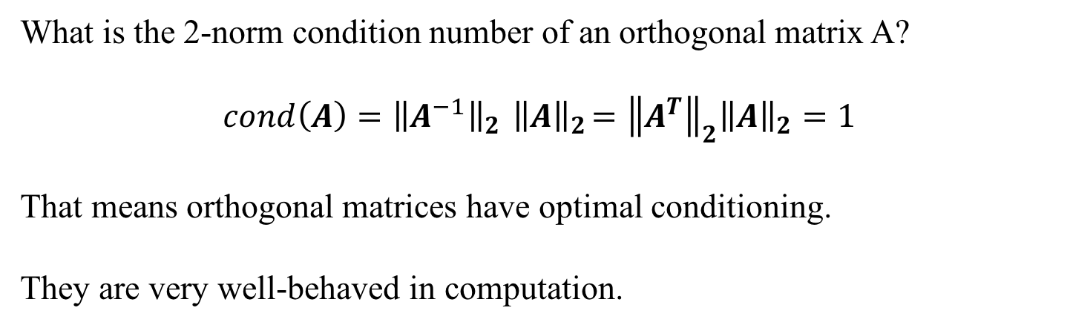
Condition Number of Orthogonal Matrices
What is the 2-norm condition number of an orthogonal matrix A?
$$cond\left(A\right)={\left\|A^{−1}\right\|}_{2}{ \left\|A\right\|}_{2}={\left\|A^{T}\right\|}_{2}{\left\|A\right\|}_{2}=1$$
That means orthogonal matrices have optimal conditioning.
They are very well-behaved in computation.

Slide 14
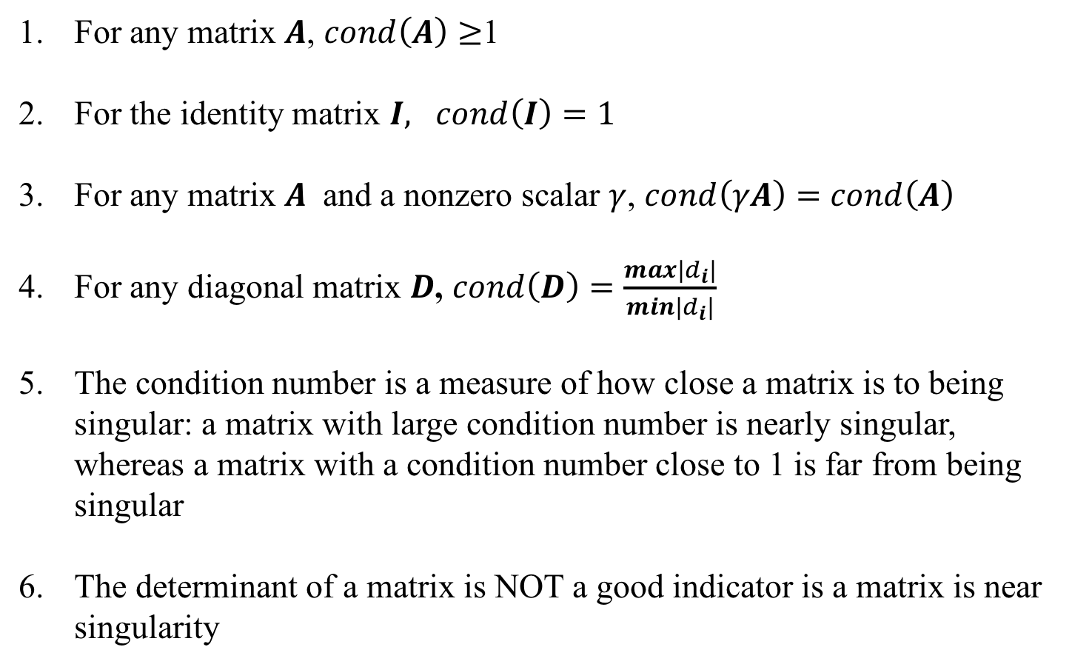
About condition numbers
For any matrix $A$, $cond\left(A\right)≥$1
For the identity matrix $I, cond\left(I\right)=1$
For any matrix $A$ and a nonzero scalar $γ$, $cond\left(γA\right)=cond\left(A\right)$
For any diagonal matrix $D$, $cond\left(D\right)=\frac{max\left|d_{i}\right|}{min\left|d_{i}\right|}$
The condition number is a measure of how close a matrix is to being singular: a matrix with large condition number is nearly singular, whereas a matrix with a condition number close to 1 is far from being singular
The determinant of a matrix is NOT a good indicator is a matrix is near singularity

Slide 15
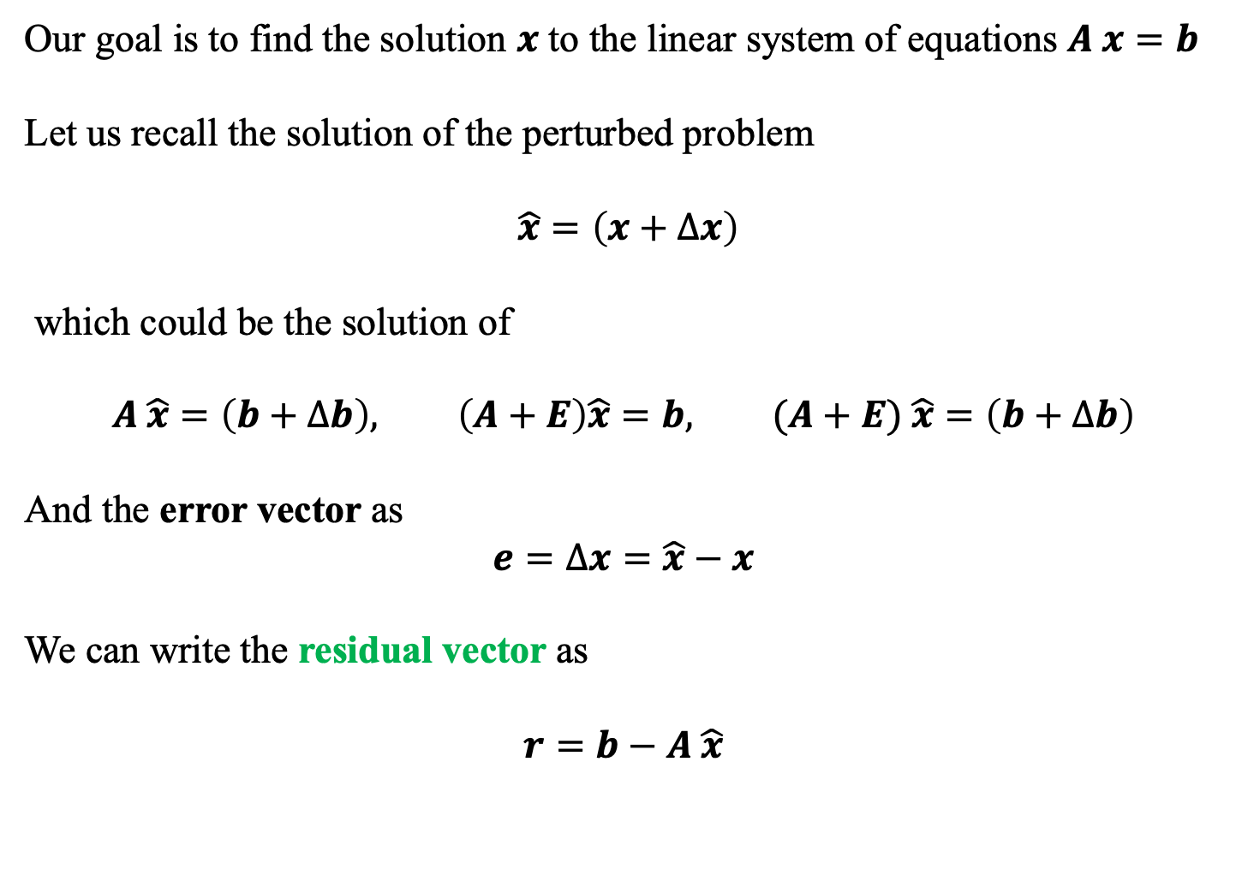
Demo “HilbertMatrix-ConditionNumber”
Residual versus error
Our goal is to find the solution $x$ to the linear system of equations $A x=b$
Let us recall the solution of the perturbed problem
$\hat{x}=\left(x+Δx\right)$
which could be the solution of
$$A \hat{x}=\left(b+Δb\right), \left(A+E\right)\hat{x}=b, (A+E) \hat{x}=\left(b+Δb\right)$$
And the error vector as
$$e=Δx=\hat{x}−x$$
We can write the residual vector as
$$r=b−A \hat{x}$$

Slide 16
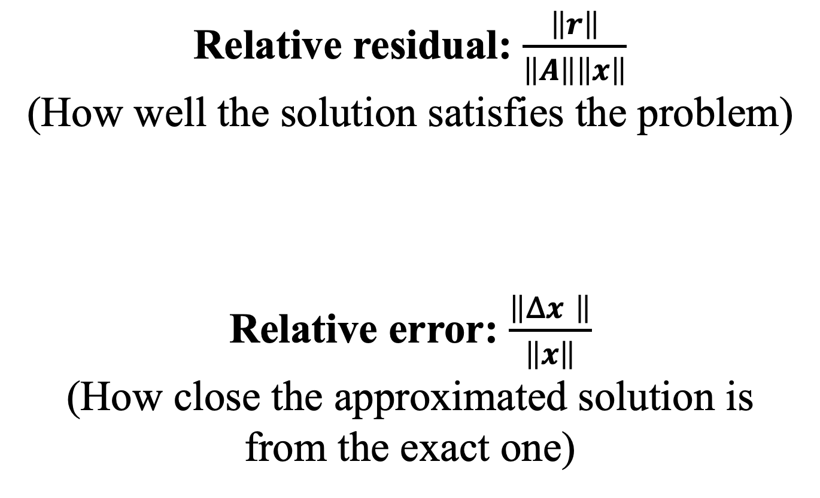
Relative residual: $\frac{\left\|r\right\|}{\left\|A\right\|\left\|x\right\|}$
(How well the solution satisfies the problem)
Relative error: $\frac{\left\|Δx \right\|}{\left\|x\right\|}$
(How close the approximated solution is from the exact one)

Slide 17
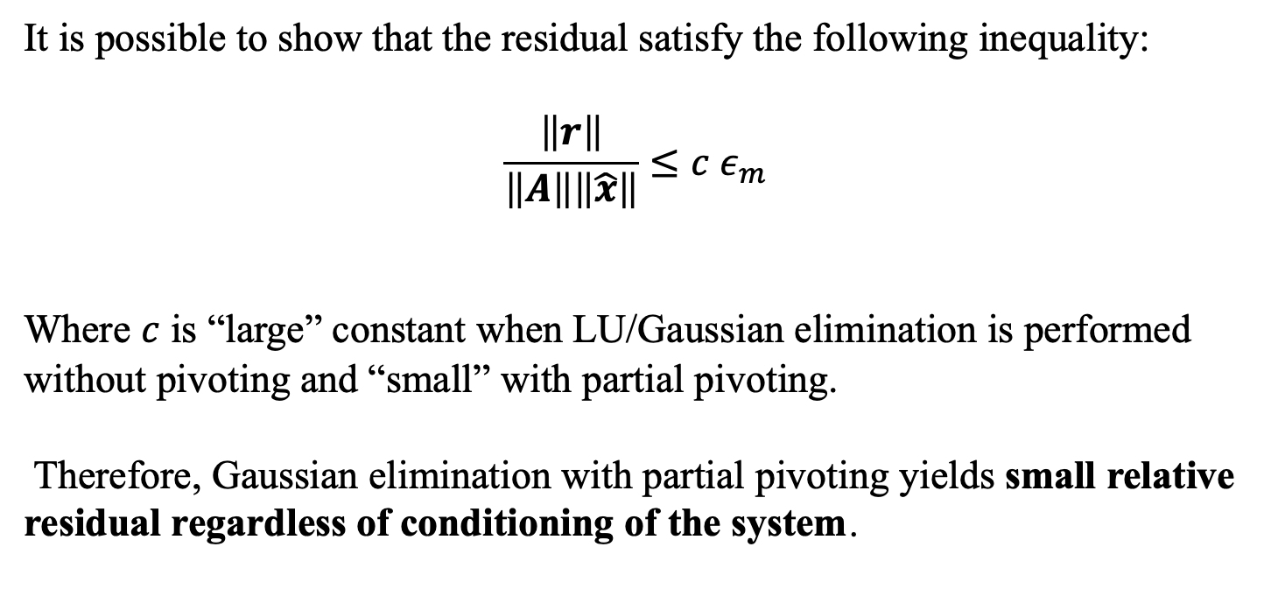
Residual versus error
It is possible to show that the residual satisfy the following inequality:
$$\frac{\left\|r\right\|}{\left\|A\right\|\left\|\hat{x}\right\|}≤c ε_{m}$$
Where $c$ is “large” constant when LU/Gaussian elimination is performed without pivoting and “small” with partial pivoting.
Therefore, Gaussian elimination with partial pivoting yields small relative residual regardless of conditioning of the system.
When solving a system of linear equations via LU with partial pivoting, the relative residual is guaranteed to be small!

Slide 18
Residual versus error
Let us first obtain the norm of the error:

Slide 19
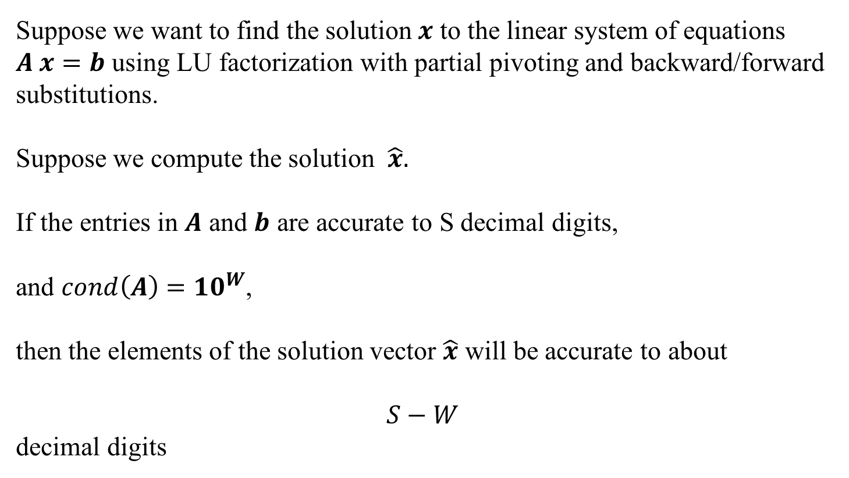
Rule of thumb for conditioning
Suppose we want to find the solution $x$ to the linear system of equations $A x=b$ using LU factorization with partial pivoting and backward/forward substitutions.
Suppose we compute the solution $\hat{x}.$
If the entries in $A$ and $b$ are accurate to S decimal digits,
and $cond\left(A\right)={10}^{W}$,
then the elements of the solution vector $\hat{x}$ will be accurate to about
$$S−W$$
decimal digits

